Slide 1

National Timing Centre Programme
ITSF 2021
Time and Frequency Dissemination to Support Innovation
Ali Ashkhasi
Senior Research Scientist
npl.co.uk/ntc

Slide 2

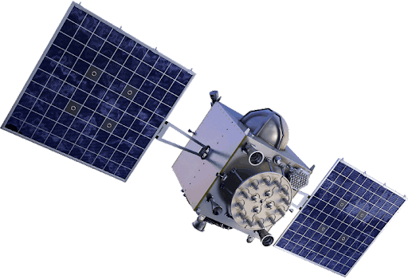


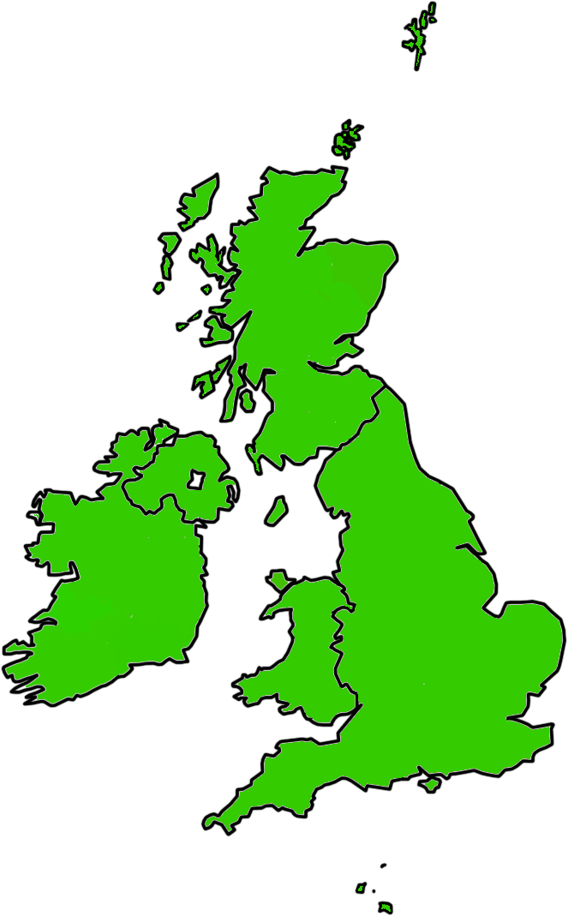





Timing in the UK
Timing is used across many sectors in many applications.
Industry currently relies heavily on GNSS signals for timing, which are vulnerable to failure.
Space
Timing and positioning
Energy
Timing and positioning
Finance
Timing
Broadcasting
Timing
Military
Timing and positioning
Emergency services
Timing and positioning
Food
Timing for positioning
Transport
Timing for positioning
Telecommunications
Timing

Slide 3
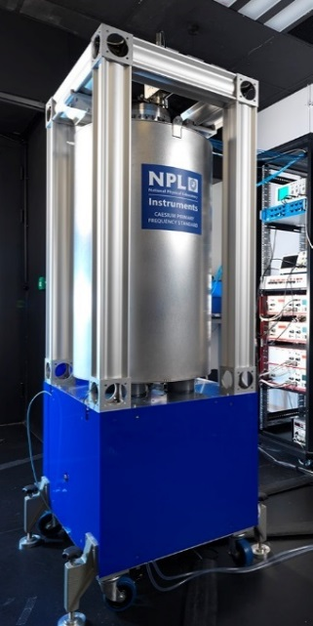


National Physical Laboratory
Internet time service
NPLTime®
MSF
NTC

Slide 4
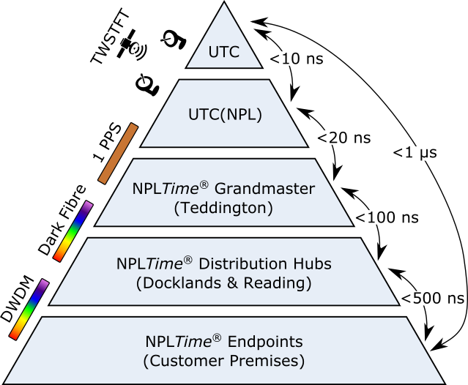
The NPLTime® service
NPLTime® provides UTC(NPL) to the Finance sector with high accuracy, traceability and security.​
Reading
London

Slide 5
National Timing Centre Programme (NTC)
Develop a resilient timing infrastructure for the UK
by building and linking a new atomic clock network
distributed geographically in secure locations
Resilience
National
Timing Centre
Provide innovation opportunities for
UK companies by funding projects
in partnership with Innovate UK
Innovation
Respond to the specialist skills shortage in
timing and synchronisation solutions
through training opportunities for
specialists, postgraduates and apprentices
Skills

Slide 6
NTC – Innovation
The development of innovation nodes is a research and development activity aimed at understanding wider industry, academic and government requirements for the resilient timing network, and at triggering the future development of an ecosystem for the delivery and use of time and frequency.
Two associated competitions fund: £6.7 million.
Support and enable business-led innovation across the UK supply chain in TFS.
Develop a TFS ecosystem and capability for relevant industries and critical national infrastructure.
Design and develop test and evaluation facilities for innovation opportunity.
Time and Frequency Signals (5 MHz, 10 MHz, 1 PPS, NTP, PTP, WR).
Testing industry and manufacturer T&F products and services.
Validating third party T&F products and services.
Innovation

Slide 7
T&F Test and Evaluation Facilities
Laboratory / R&D environment / Commercial data-centre environment.
Teddington
Dark Fibre
Dark Fibre
Range of High quality T&F signals 1 PPS , 10 MHz , 100 MHz
Synchronisation of devices to UTC(NPL) by PTP and WR
Reading
Docklands
Access to resilient PTP & WR signal traceable to UTC(NPL) via optical fibre
Access to range of test & measurement hardware
Access to resilient PTP signal traceable to UTC(NPL) via optical fibre

Slide 8
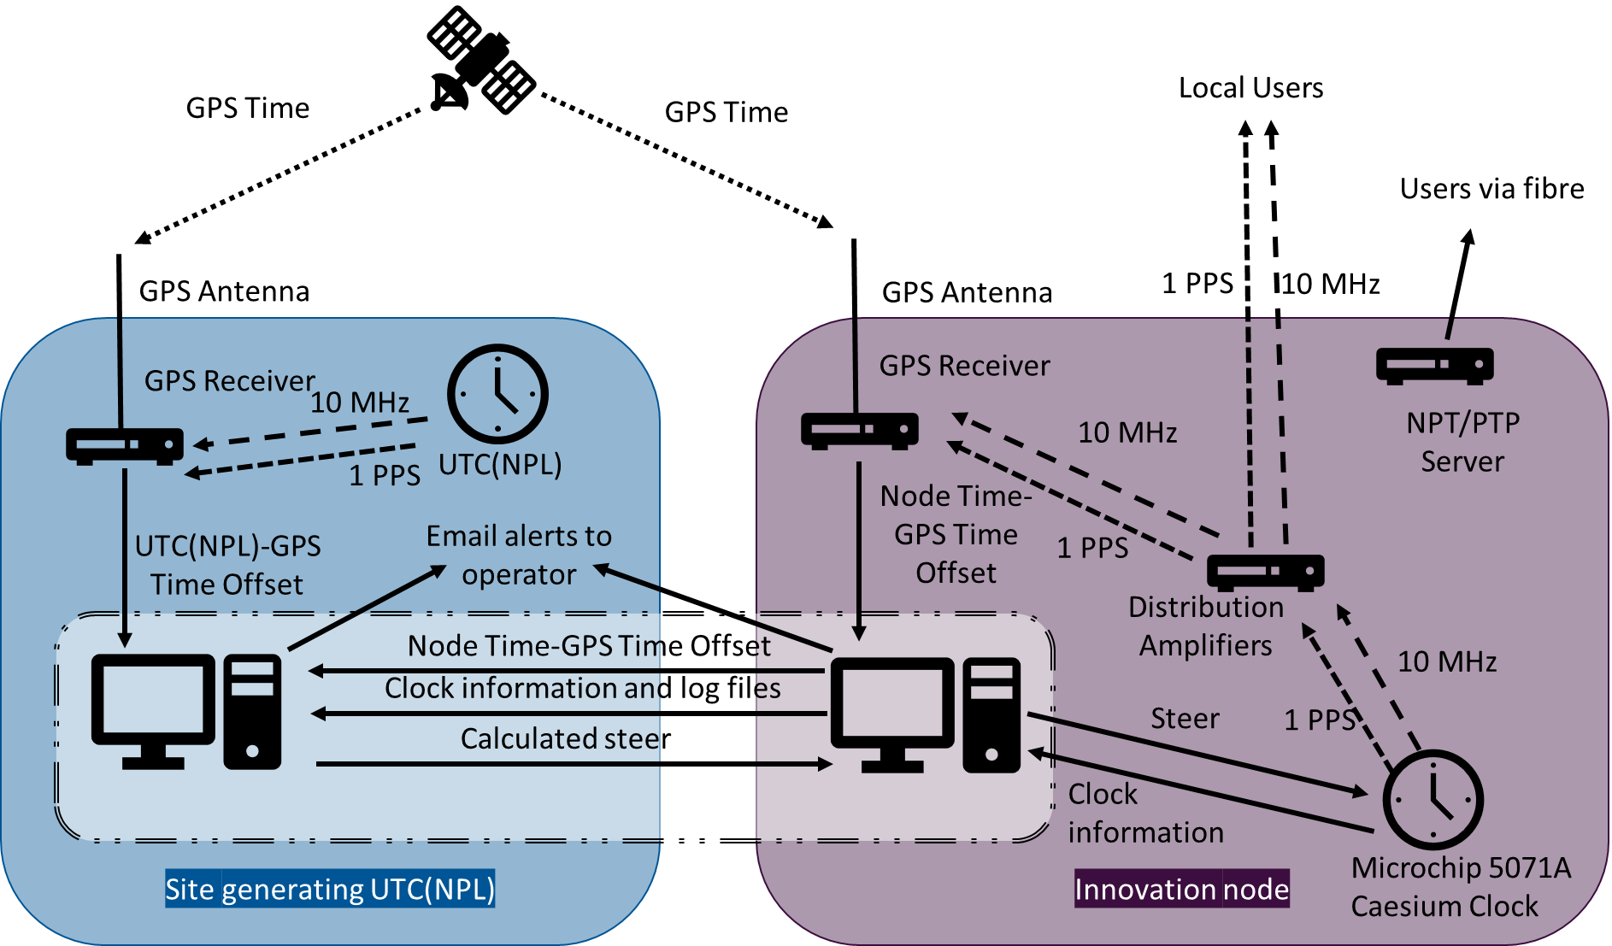
Developing University of Strathclyde Node
The node will be a source for distributing time and frequency signals for research and development purposes in the local geographical area.
To support the innovation objective of the NTC programme, NPL is creating a timing distribution centre in Scotland.
A distant time scale realisation traceable to UTC(NPL) based on a Microchip 5071A caesium clock.
The clock is monitored via a GPS common view time transfer link and steered from NPL.

Slide 9
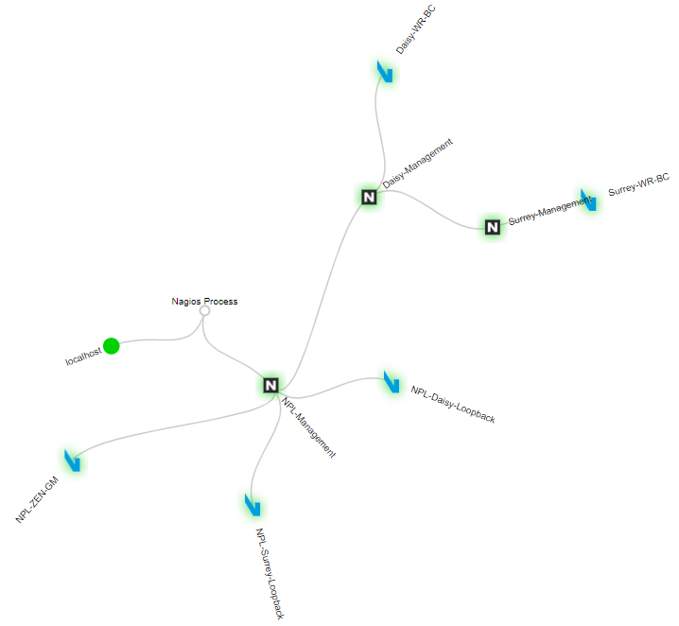
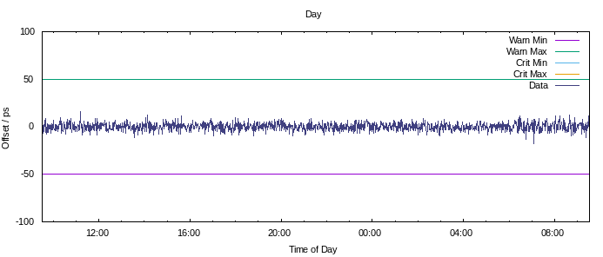
Developing University of Surrey Node
NPL is creating a timing distribution centre at the university of Surrey.
T&F signals (1 PPS and 10 MHz).
Synchronization to UTC(NPL) using WR-PTP.
24/7 Monitoring.
Endpoint Offset from GM

Slide 10
Summary
Under I-UK call 1, over £2m invested in 17 feasibility studies, studying innovative dissemination and applications of TFS.
Second competition opening date will be March 2022 and will offer opportunities for demonstrator projects as well as feasibility studies.
The prototype innovation node for Scotland has been designed, developed and tested at NPL. We are aiming to install the final solution at University of Strathclyde by April 2022.
The University of Surrey innovation node is under the final test stages. The WR signal traceable to UTC(NPL) with 1 PPS and 10 MHz signals will be available for different applications in few months.

Slide 11

Thank you for listening!
National Time Scale Group
National Physical Laboratory
The National Physical Laboratory is operated by NPL Management Ltd, a wholly-owned company of the Department for Business, Energy and Industrial Strategy (BEIS).
npl.co.uk/ntc
© NPL Management Limited, 2021

